Slide 1
Introduction to Conflict Escalation by Jae Morgans Conflict Engagement Specialist

Slide 2
Goal for this presentation
Introduce the concept of productive conflict engagement and;
Create awareness around the importance of early productive conflict engagement

Slide 3
Conflict: to be different, opposed, or contradictory: to fail to be in agreement or harmony.
Conflict Engagement refers to any activities meant to address conflict.
Destructive Conflict Engagement views conflict as something negative, unwanted, and harmful and can lead to ignoring the reality of conflict and its root causes
Productive Conflict Engagement aims to reframe our approach to conflict in a more positive way.
Notes:
Our intention would be to be purposeful about.
Destructive :
Filled with aggressive behavior, Assists with keeping people on the defensive, Shuts down perspectives
Suppresses knowledge sharing, Promotes resentment, which leads to anxiety and disconnection from people
LAGGARD AND INOPPORTUNE
Creates the opportunity to explore ideas, practice problem solving, and learn how other people express ideas and opposition
Discussions are based on mutual respect and trust
Creates a deeper connection through the building of understanding
Facilitates learning and reflection, promotes creativity
RESPONSIVE, TIMELY and PURPOSEFUL

Slide 4
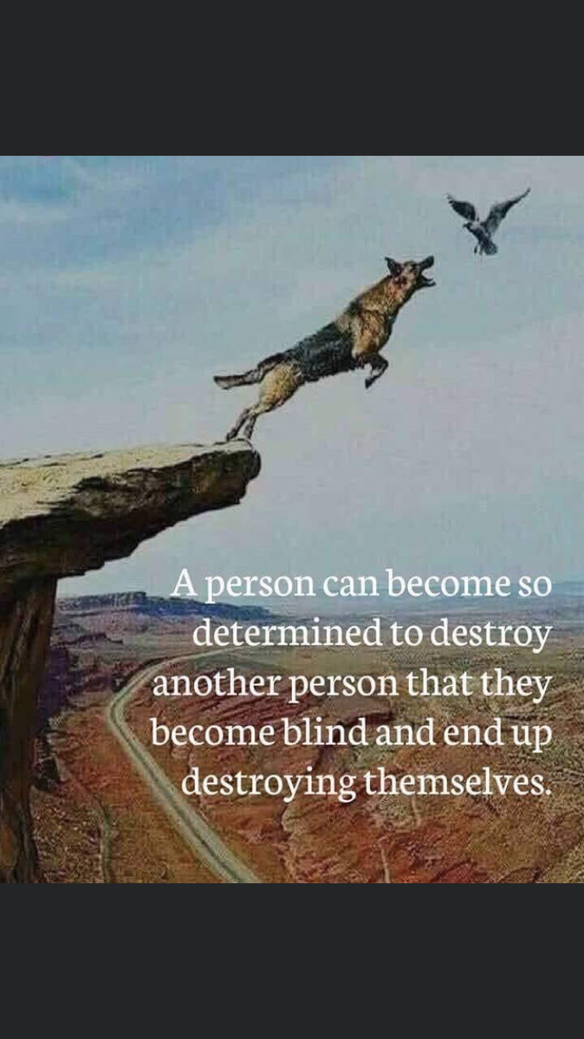

Slide 5
Conflict Escalation
Friedrich Glasl is an Austrian Economist and Mediation Consultant that is best known for developing a conflict escalation model that represents in a top-down form how conflict manifests itself when conflict escalation is occurring.

Slide 7
SUMMARY
Peak Impact
High
Discomfort
Manage the Emotion
Level 3
Timely / Appropriate Intervention
Level 2
Early Identification of conflict
Level 1
Low
Short
Time Spent in Conflict
Long
Higher cost, more turnover, complex interventions required in order to manage the conflict.

Slide 8
Conclusion

